Slide 1
C# 8.0
is here

Slide 2
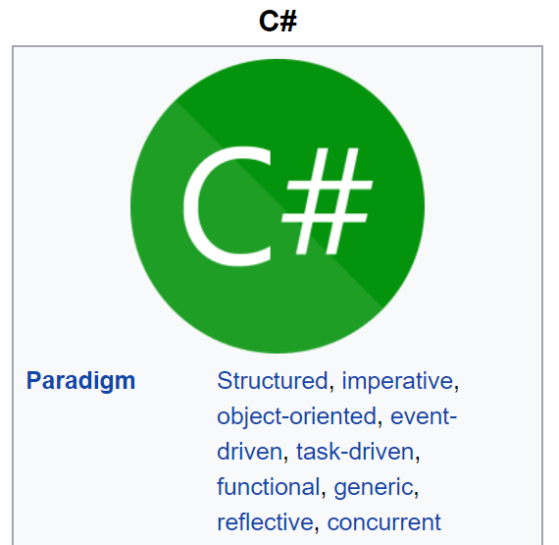
Multiparadigm

Slide 3
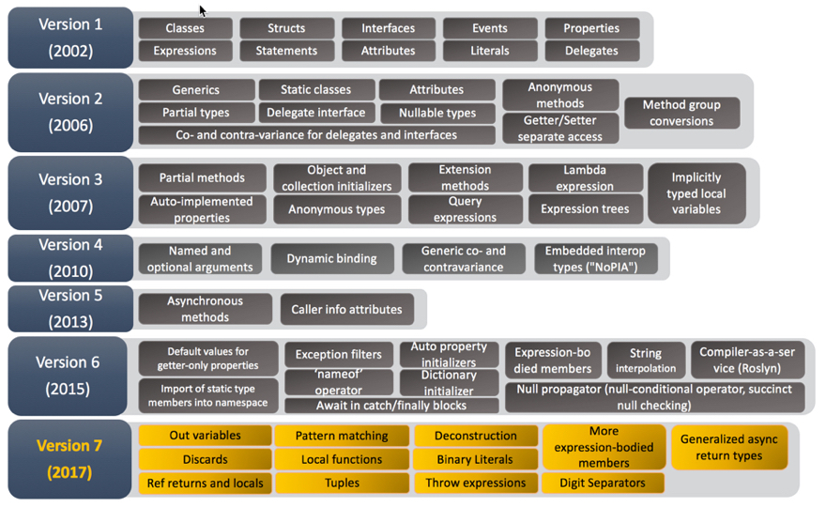
Evolution of C#

Slide 4
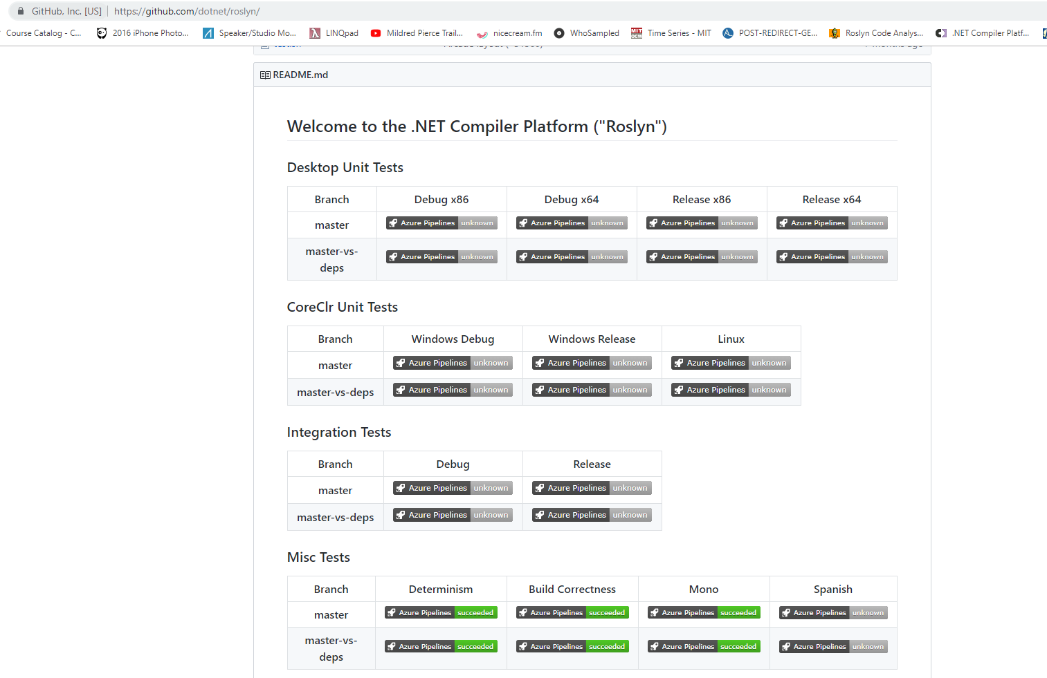
Roslyn (Compiler as a Service)

Slide 5
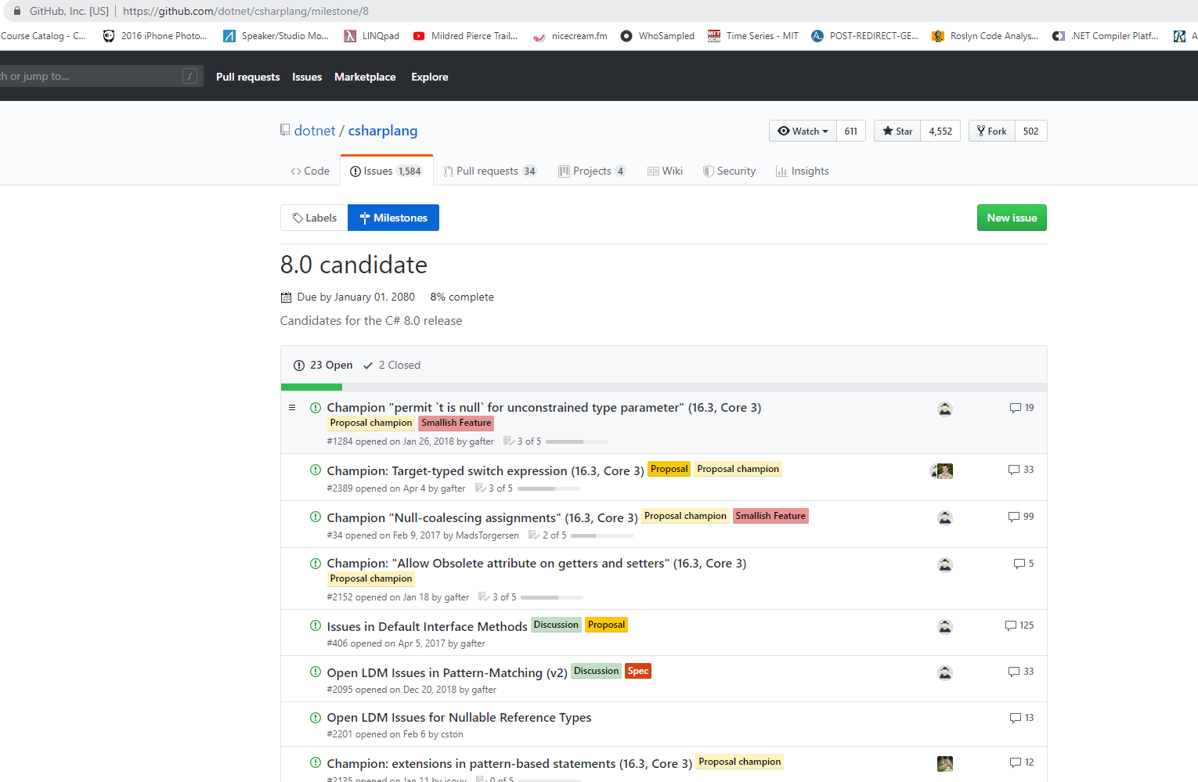
Csharplang

Slide 6

https://github.com/dotnet/csharplang/milestone/8

Slide 7

Shipping of VS2019, .NET Core 3.0 & C# 8.0

Slide 8
Tuples & Pattern Matching
In mathematics, a tuple is a finite ordered list (sequence) of elements […] for example, (2, 7, 4, 1, 7) [https://en.wikipedia.org/wiki/Tuple]
In computer science, pattern matching is the act of checking a given sequence of tokens for the presence of the constituents of some pattern [https://en.wikipedia.org/wiki/Pattern_matching]

Slide 9
Tuples & Pattern matching in C# 7.0
Code demo

Slide 10
Tuples & Pattern matching in C# 8.0 Overview
Switch expressions
Positional Patterns
Property Patterns
Type patterns
Default pattern
Tuple Patterns

Slide 11
Tuples & Pattern matching in C# 8.0 Switch statement vs expressions (1)
In computer programming, a statement is a syntactic unit of an imperative programming language that expresses some action to be carried out.^{[1]} A program written in such a language is formed by a sequence of one or more statements. A statement may have internal components (e.g., expressions). [https://en.wikipedia.org/wiki/Statement_(computer_science)]
An expression in a programming language is a combination of one or more constants, variables, operators, and functions that the programming language interprets (according to its particular rules of precedence and of association) and computes to produce ("to return", in a stateful environment) another value. This process, as for mathematical expressions, is called evaluation. [https://en.wikipedia.org/wiki/Expression_(computer_science)]

Slide 12
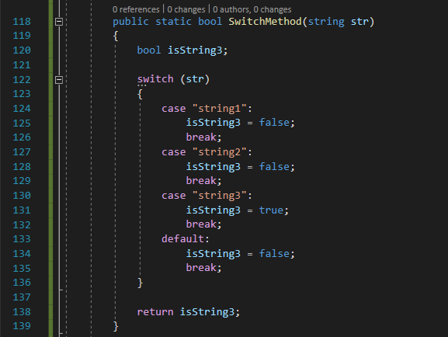
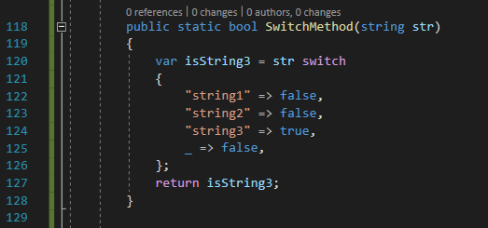
Tuples & Pattern matching in C# 8.0 Switch statement vs expressions (2)

Slide 13
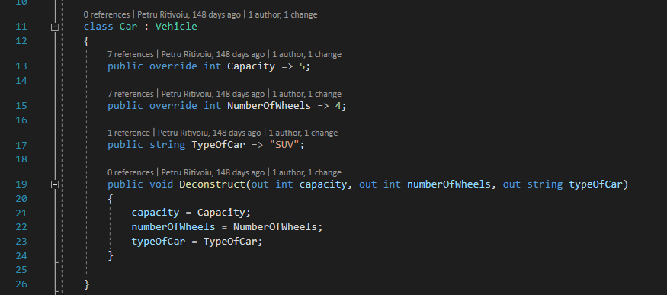
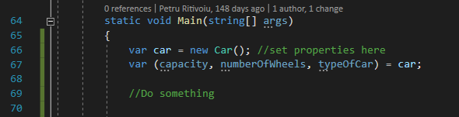
Tuples & Pattern matching in C# 8.0 Object deconstruction

Slide 14
Tuples & Pattern matching in C# 8.0
Code demo

Slide 15
Ranges & Indices
Range class
Index operator
Code demo

Slide 16
Readonly members
Motivations:
Making it clear which method or property mutates the state (or is allowed to)
Compiler optimization, explicitly for in parameters
Code demo (compiler optimization) very-long-link
Code demo (day-to-day usage)
Opinion: We now have a contract for pure functions

Slide 17
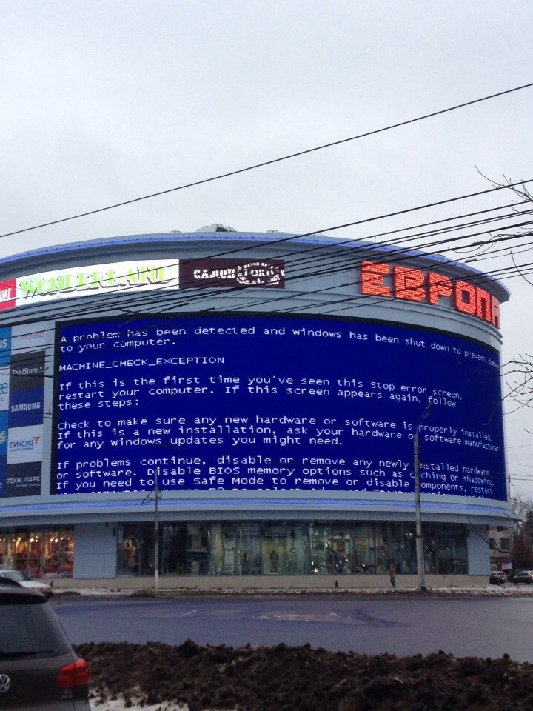

Nullable Reference Types (1)

Slide 18
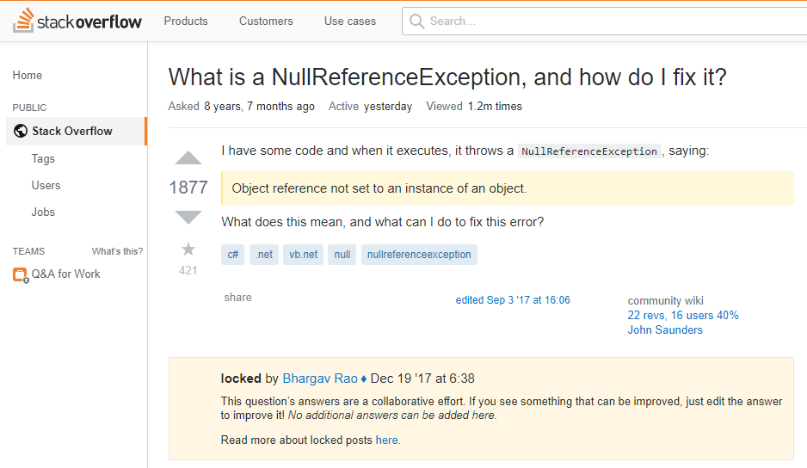
Never seen it before

Slide 19
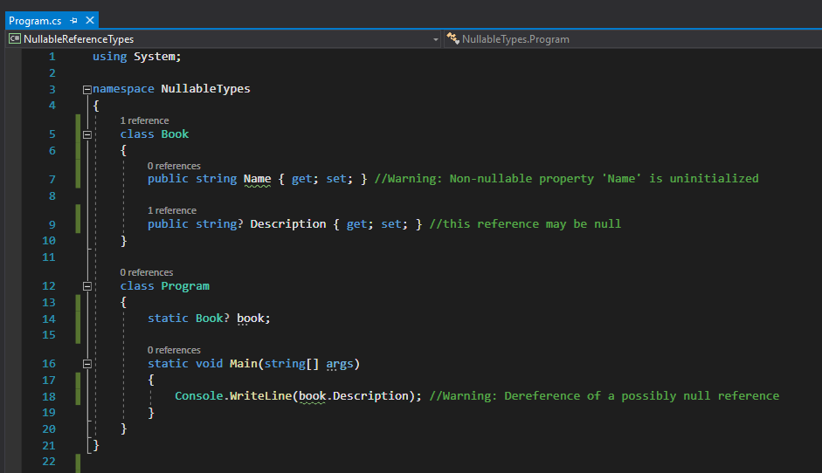
(Explicitly) Nullable Reference Types (2)
Aren’t all reference types nullable already?
They are indeed.

Slide 20
Nullable Reference Types (3)
Breaking Change?
Book book; has a different meaning between C# 7.0 and 8.0
Well, not really
The feature is Opt-in
It only gives warnings
IL is fully compatible between C# 7 & 8

Slide 21
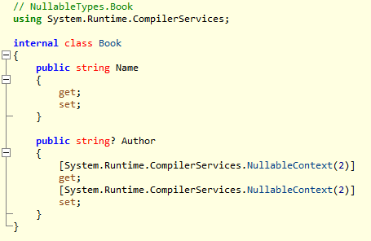
Nullable Reference Types (4)
What does the compiler actually translate “string? str” into?
Nullable<int> vs [Nullable] string
This is why it is not a breaking change

Slide 22
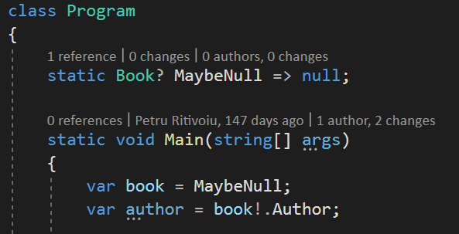
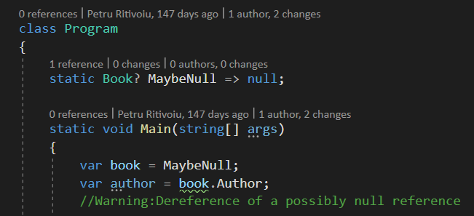
Nullable Reference Types (5)
The null forgiving operator: !

Slide 23
Nullable Reference Types (6)
Recap:
There are 2 states a variable can be in: Nullable and NonNullable
The nullability can be modified by these 2 operators: ? and !
Nullable? => NonNullable
NonNullable! => Nullable

Slide 24
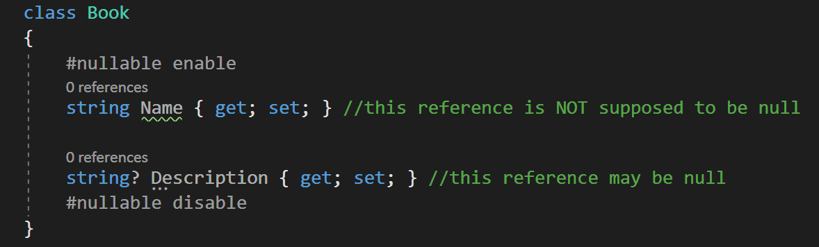
Enabling nullable context
Project wide: <Nullable>enable</Nullable>
In code:
More info can be found here: https://docs.microsoft.com/en-us/dotnet/csharp/nullable-references

Slide 25
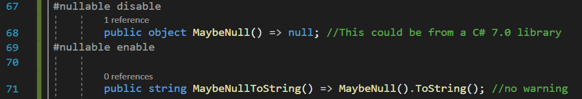
Oblivious State

Slide 26
Thoughts?
Do you think this new feature will be adopted by the majority of C# developers?

Slide 27
Using declarations
Code demo - Not much to say here

Slide 28
Static Local Functions
Local functions were first introduced in C# 7.0
Github champion: https://github.com/dotnet/csharplang/issues/1565
Motivation [Microsoft]: Avoid unintentionally capturing state from the enclosing context. Allow local functions to be used in scenarios where a static method is required https://docs.microsoft.com/en-us/dotnet/csharp/language-reference/proposals/csharp-8.0/static-local-functions
Short story why: Performance. Capturing context is a potentially expensive operation (the runtime will copy all the variables in the current context to the local function’s stack memory)
Nice article: http://techxposer.com/2019/08/03/c-8-0-static-local-functions/

Slide 29
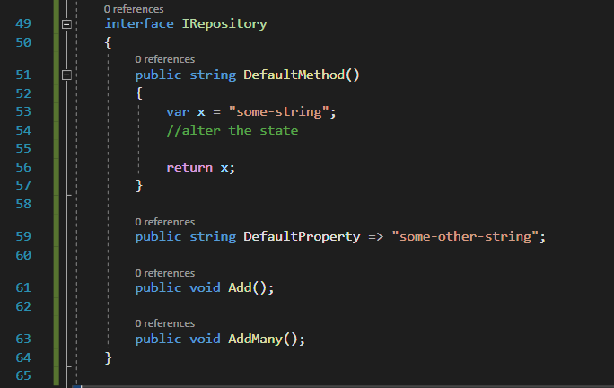
Default Interface Members

Slide 30
Async Streams
Yield: When you use the yield contextual keyword in a statement, you indicate that the method, operator, or get accessor in which it appears is an iterator. Using yield to define an iterator removes the need for an explicit extra class (the class that holds the state for an enumeration, see IEnumerator<T> for an example) when you implement the IEnumerable and IEnumerator pattern for a custom collection type. [https://docs.microsoft.com/en-us/dotnet/csharp/language-reference/keywords/yield]
We can use yield keyword when iterating collections, why can’t we use it when reading from streams?
Code demo

Slide 31
Find me on github
https://github.com/PetruRitivoiu/csharp8

Slide 32
Any questions?

Slide 33
Thank you for your attention, hope you enjoyed ☺

